Slide 1
SAINIK SCHOOL GOPALGANJ
CLASS –IX
CHAPTER –MOTION
BY
Dr A K CHOUBEY (TGT)

Slide 2
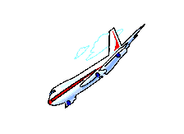
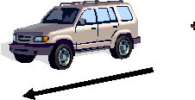
CHAPTER 8
MOTION

Slide 3
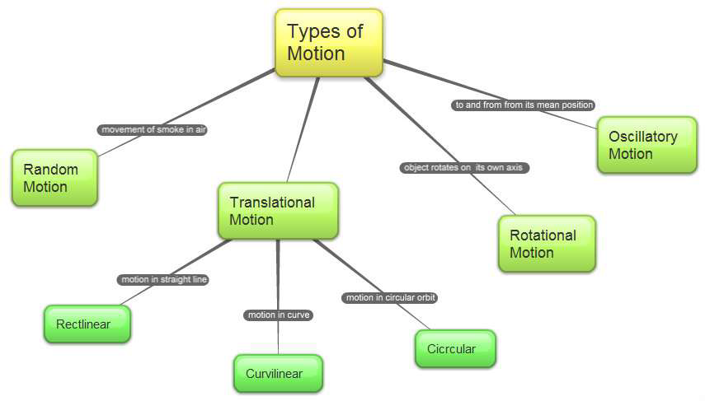

Slide 4
Motion is defined as the change in position of body with time.
To describe the position (location) of an object we need to specify a reference point called the origin.
Let us assume that a school in a village is 2 km north of the railway station. We have specified the position of the school with respect to the railway station. In this example, the railway station is the reference point. We could have also chosen other reference points according to our convenience.

Slide 5
Concept of Rest and Motion
A body is said to be in rest if its position does not vary with respect Rest to a given referral point as time passes. Motion: A body is said to be in motion if there is a continues change in its position with respect to a given referral as time passes. Concept of rest and motion is related to referral change in position so a single object can be at rest or motion same time with different referral points. If we consider a single object as referral point and consider it as rest, as a absolute point any object which is at rest with respect to that point is considered at rest and same case with motion. In general we consider Earth as absolute point considering it at rest, Although It is in motion with respect to Sun and other planets

Slide 6
Distance And Displacement
The actual path covered during motion of The Change in position made during a body It is needed not to be the Shortest path between two points It is the Scalar quantity as It does not have any particular direction motion of a body is known as displacement It is the shortest path between initial and final position It is a vector quantity as it is always directed.

Slide 7
Concept of Rate of Motion:
Rate is defined as ratio of change in two quantities Rate is of two types . Average Rate of quantity A with respect to B net change in A net change in B .lnstantaneous Rate is rate at an Instant that is for very short interval of time. .Speed, Velocity and Acceleration are examples of Rate. Speed=Distance/Time
Average Speed =Total Distance Travelled/Total Time Taken

Slide 8
Uniform and non Uniform motion
Uniform Motion- If a body travels equal distance in equal intervals of time then it is in uniform motion
Non-uniform motion- If a body travels unequal distance in equal intervals of time then it is in uniform motion

Slide 9
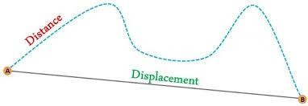
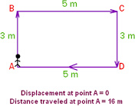
Distance and Displacement
Distance= the total path length covered by an object from the initial position to the final position .
Displacement= The shortest distance between the initial and the final position.

Slide 10
Measuring the Rate of Motion- Different objects may take different amounts of time to cover a given distance. Some of them move fast and some move slowly. One of the ways of measuring the rate of motion of an object is to find out the distance travelled by the object in unit time. This quantity is referred to as speed.
Speed=Distance/Time
Average Speed =total distance travelled/Total time taken

Slide 11
Velocity
The rate of motion is more meaningful if we specify if we specify its direction of motion with speed, which is termed as velocity.
It is a vector quantity. Velocity=Dispalcement/Time
Average velocity= Total Dispalcement/Total Time
=v+u/2

Slide 12
ACCELERATION
The quantity which specifies changes in velocity is acceleration.
Acceleration :- It is the change in velocity of a body per unit time. ( or
the rate of change of velocity.)
Acceleration = Change in velocity/
Time
If the velocity of a body changes from initial value u to final value v in
time t, then acceleration a is
a = v – u/t .The SI unit of acceleration is ms - 2

Slide 13
Acceleration
The rate of change of velocity is termed as acceleration. (During non-uniform motion)
Acceleration =a=v-u/t
Its SI unit is m/s2
Uniform acceleration-When the change in velocity is equal in equal intervals of time.
Non-Uniform acceleration-When the change in velocity is unequal in equal intervals of time.

Slide 14
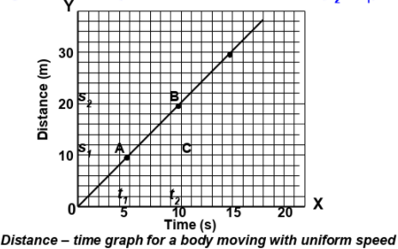
Distance time graphs
For a body moving in uniform motion

Slide 15
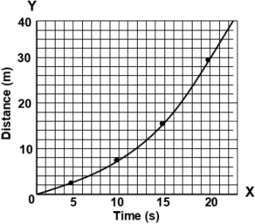
For a body moving with non-uniform speed

Slide 16
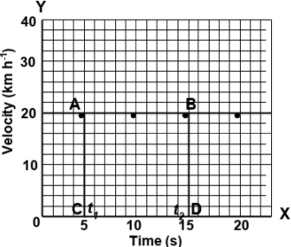
Velocity Time Graphs
For a body moving with uniform velocity

Slide 17
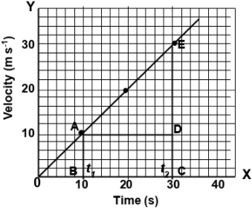
For a body moving with non-uniform acceleration

Slide 18
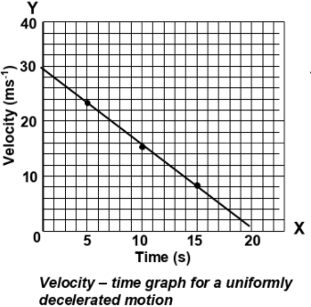

Slide 19
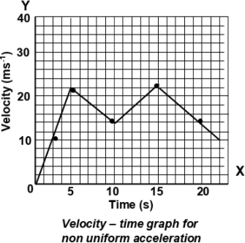

Slide 20
EQUATIONS OF MOTION
V=u+at (velocity time relation)
S=ut+1/2at²(position time relation)
V²-u²=2as (position velocity relation)

Slide 21
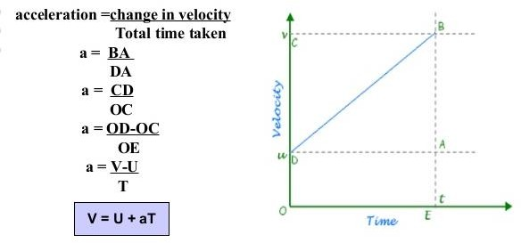
Derivation of the first equation of motion

Slide 22
Derivation of the second equation of motion

Slide 23
Uniform circular motion :-
If a body moves in a circular path with uniform speed, its motion is called uniform circular motion.
Uniform circular motion is accelerated motion because in a circular motion a body continuously changes its direction.
The circumference of a circle of radius r is given by 2πr.

Slide 24
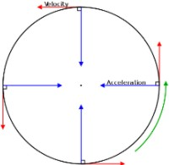
Circular motion
The motion of a body in a circular path is called a circular motion.
For a uniform circular motion

Slide 25
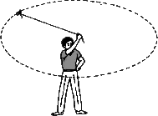
Take a piece of thread and tie a small piece of stone at one of its ends. Move the stone to describe a circular path with constant speed by holding the thread at the other end.
Now, let the stone go by releasing the thread.
Repeat the activity for a few times by releasing the stone at different positions of the circular path, check whether the direction in which the stone moves remains the same or not.
OBSERVATION- on being released the
stone moves along a straight line
Acitivity
tangential to the circular path. This shows that the direction of motion changed at every point when the stone was moving along the circular path.
Uniform circular motion is an
accelerated motion

